Slide 1
Conditional Formatting
By: Emily Diniz and Hannah Przystac

Slide 2
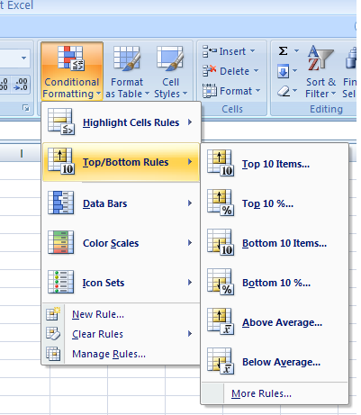
Top 10%
To find the top 10% of a set of data, select the cells that contain the information you want to sort.
Next go to the conditional formatting tab in the ribbon and
select “Top/Bottom Rules” from the drop down list.
Then click on the “Top 10%” tab.
Excel will give options as to how you choose to present the information. (Different colors are provided.)

Slide 3
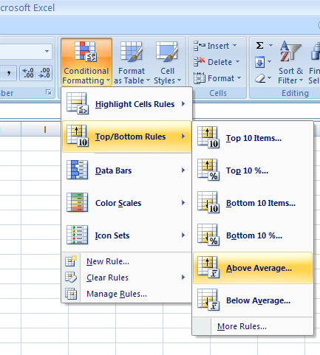
Above Average
To find the data above the average mark in the set, select the cells in which you want to sort.
Next go to the conditional formatting tab in the ribbon and select “Top/Bottom Rules” from the drop down list.
Then click on the “Above Average” tab.
Excel will give options as to how you choose to present the information. (Different colors are provided.)

Slide 4
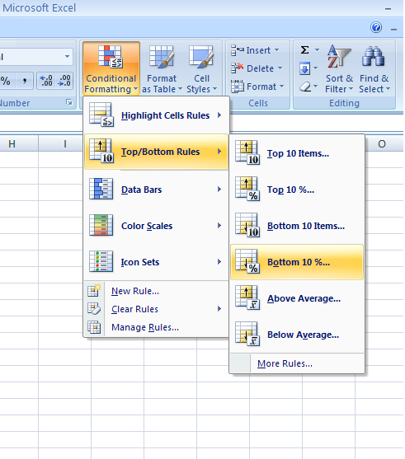
Bottom 10%
To find the bottom 10% of a set of data, select the cells that contain the information you want to sort.
Next go to the conditional formatting tab in the ribbon and
select “Top/Bottom Rules” from the drop down list.
Then click on the “Bottom 10%” tab.
Excel will give options as to how you choose to present the information. (Different colors are provided.)

